Slide 1
SOLARSAFE – Dehumidifier
James Edwicker, Zac Heggie, Josh Tuckwell

Slide 2
Context
Roughly 4.5 billion people and 1/4 of the world's food crops affected by Aflatoxin contamination.
Disproportionately impacts smallholder farmers.
Aflatoxin causes several billion dollars annually in crop losses, increased health care costs and trade restrictions.
Contamination is amplified by poor drying practices, when maize retains moisture or is exposed to rain.

Slide 3
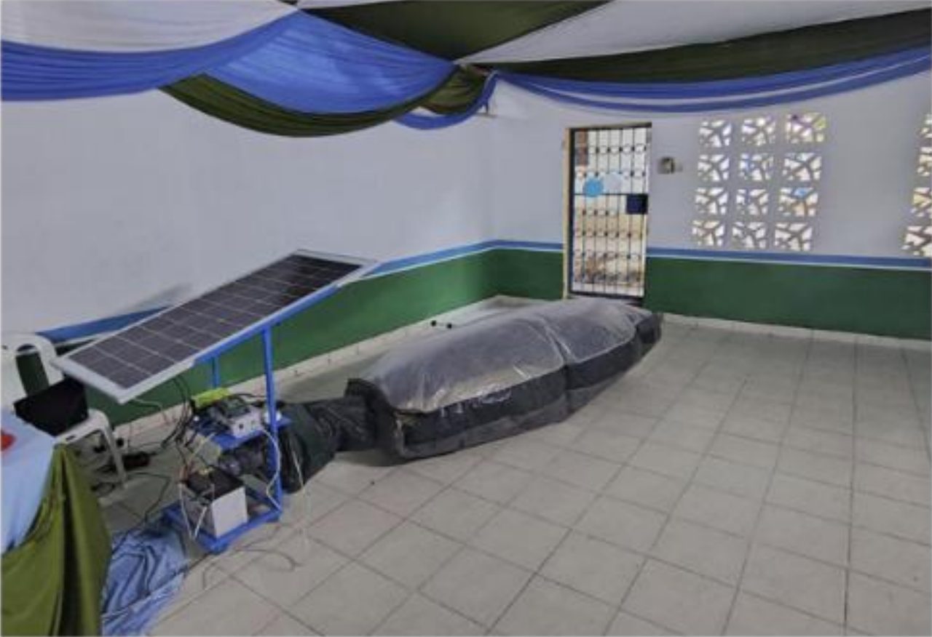
Existing Product
Solar Cell
Inflated Bag
Controller
Fan and Motor
Battery

Slide 4
Benefits if Successful
Should effective drying be able to take place:
Maize would be healthier as Aflatoxin carrying fungus would be less capable of growing and contaminating the food.
Maize would be safe for longer, decreasing waste.
Maize would be more valuable, bringing prosperity to the farmers.

Slide 5
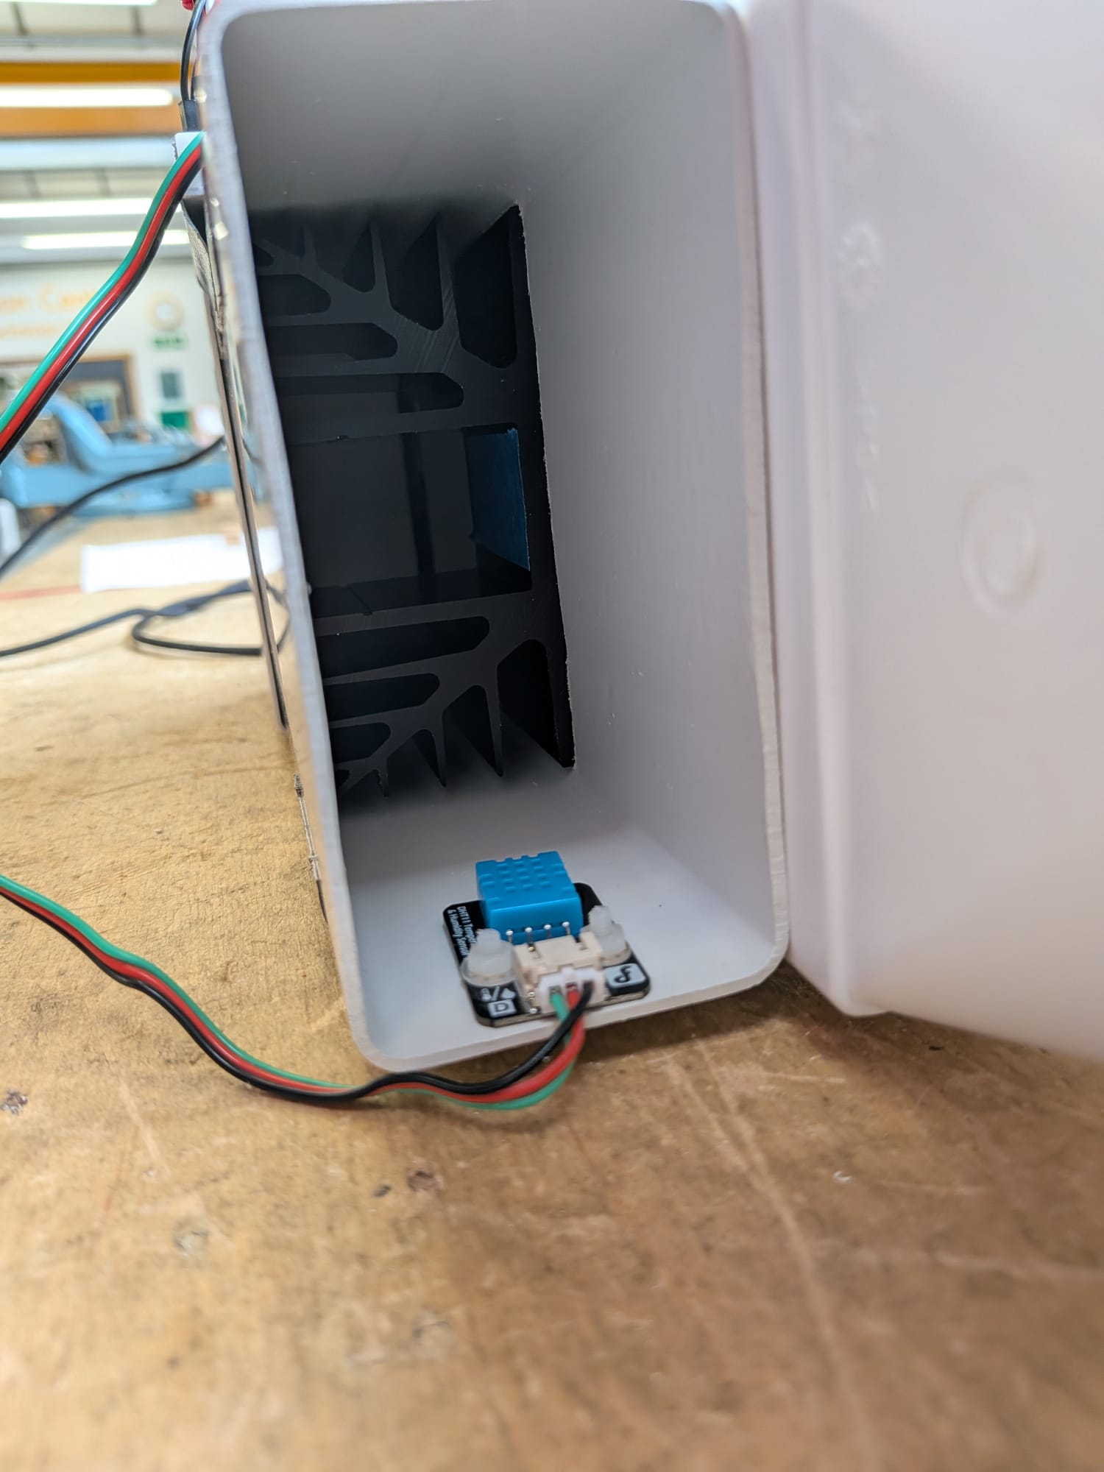
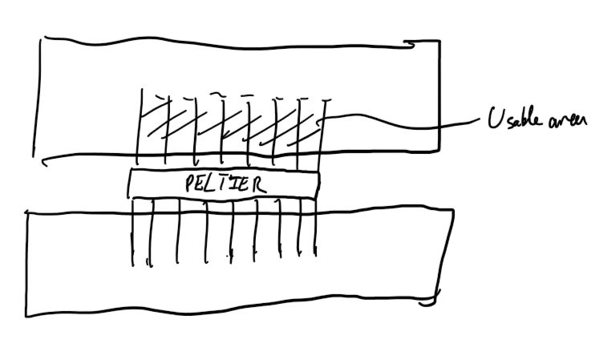
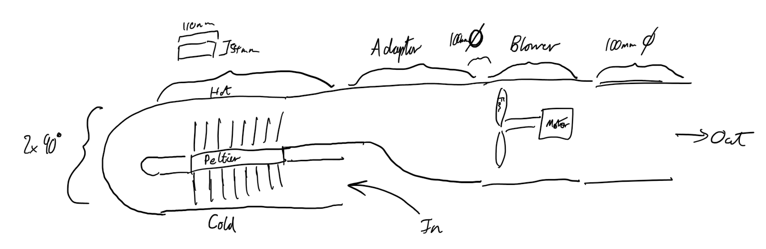
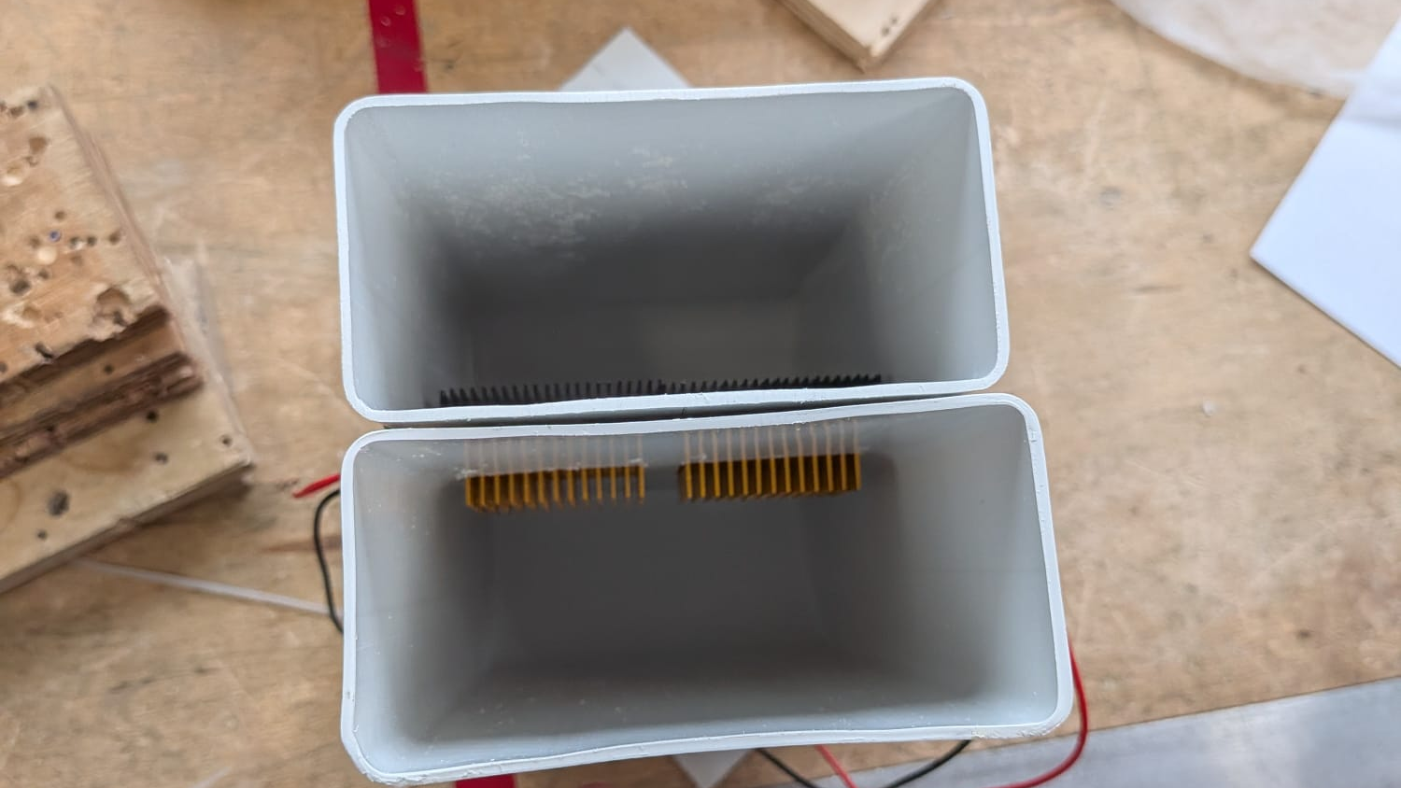
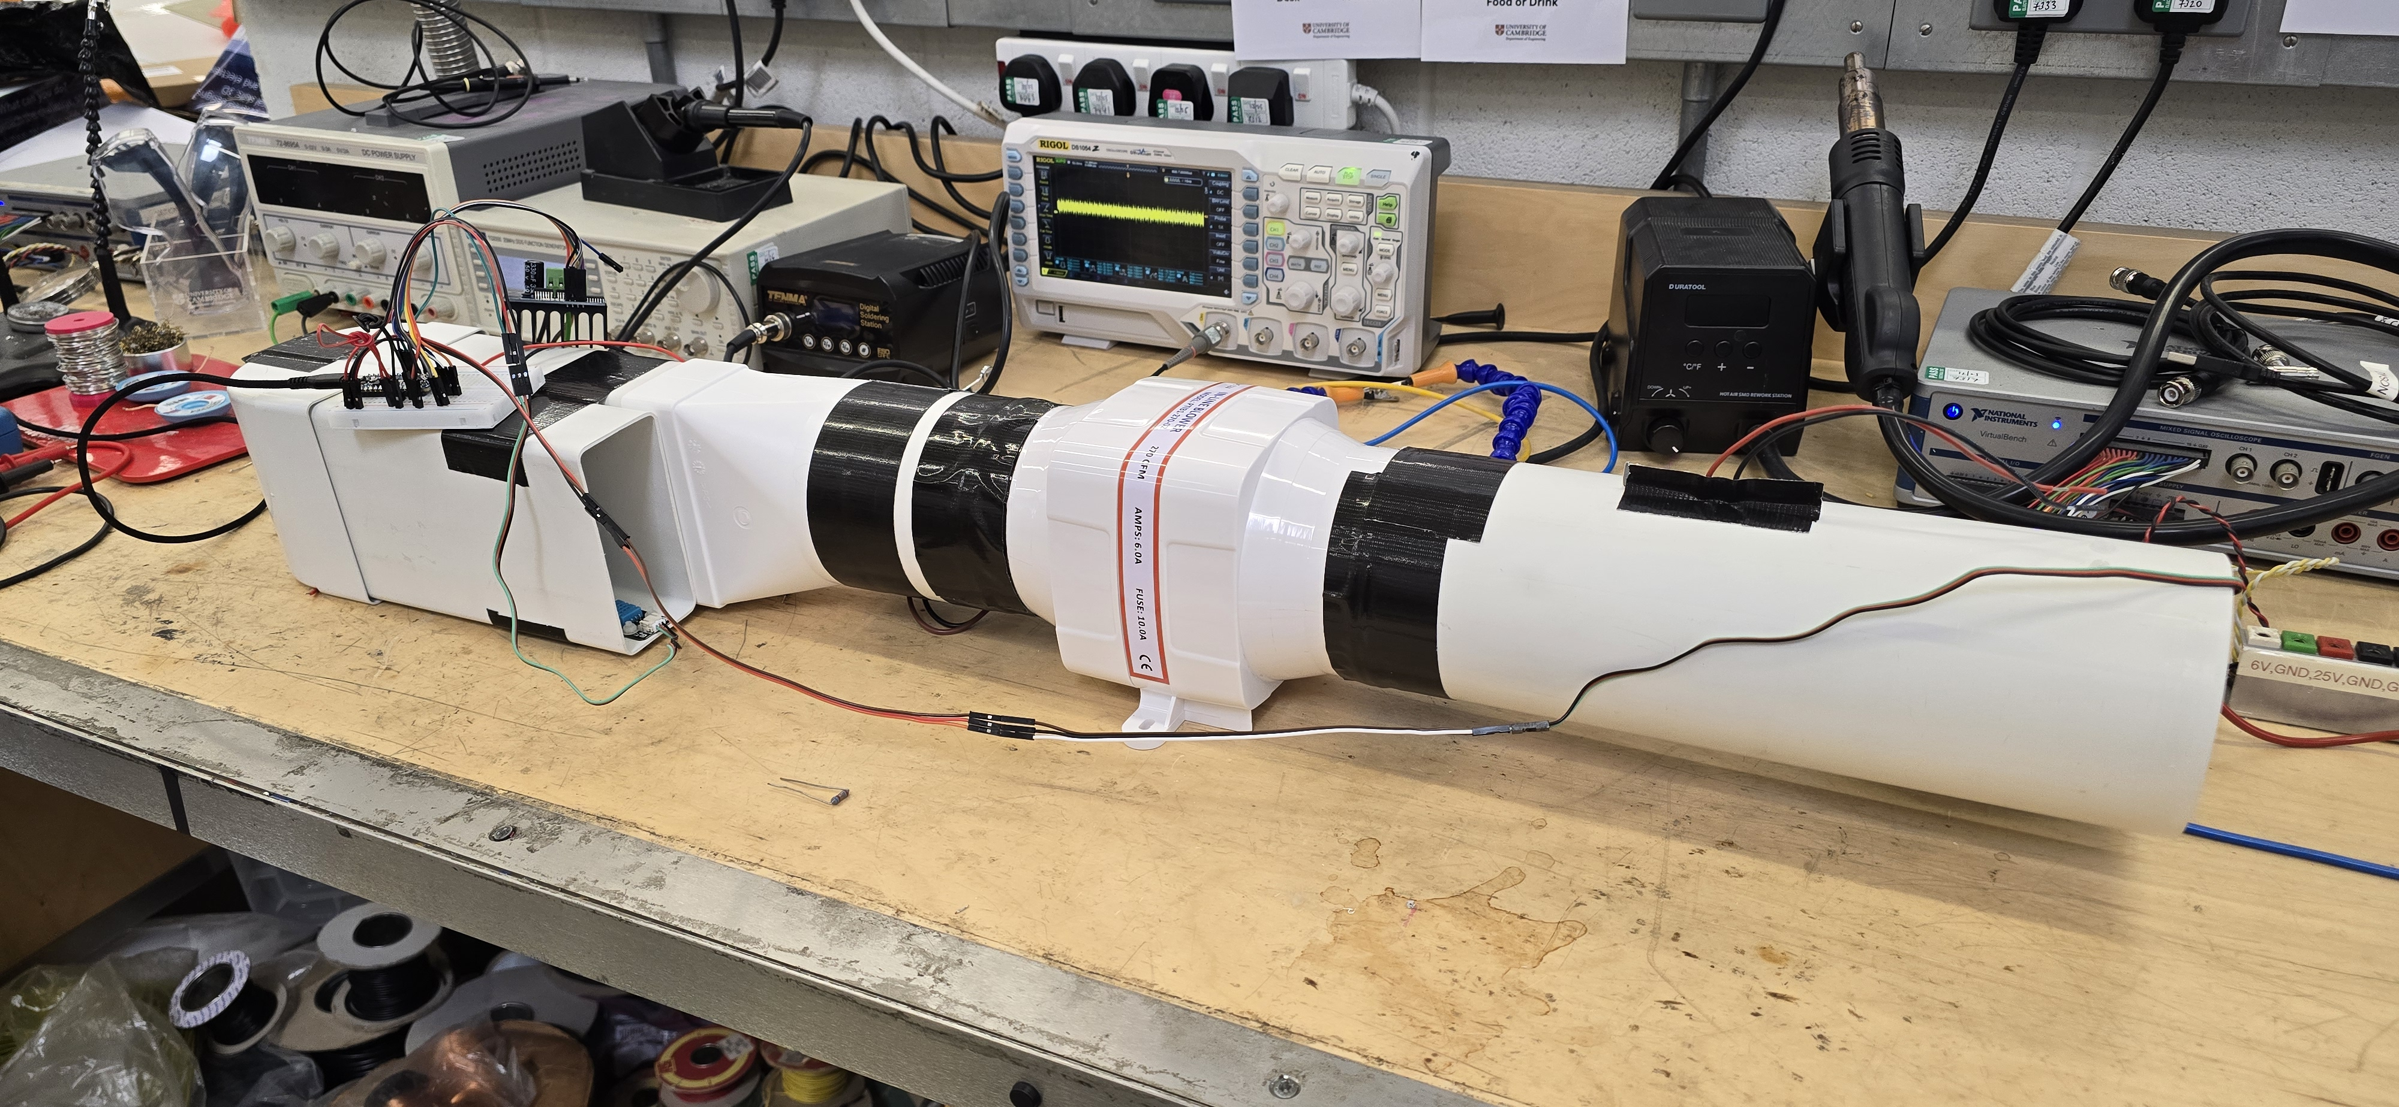
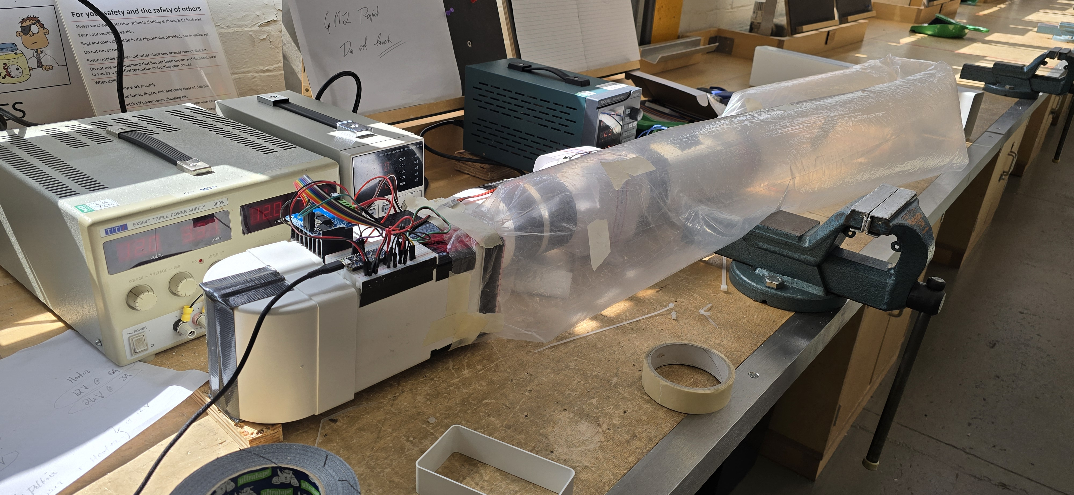
Mechanical Design

Slide 6
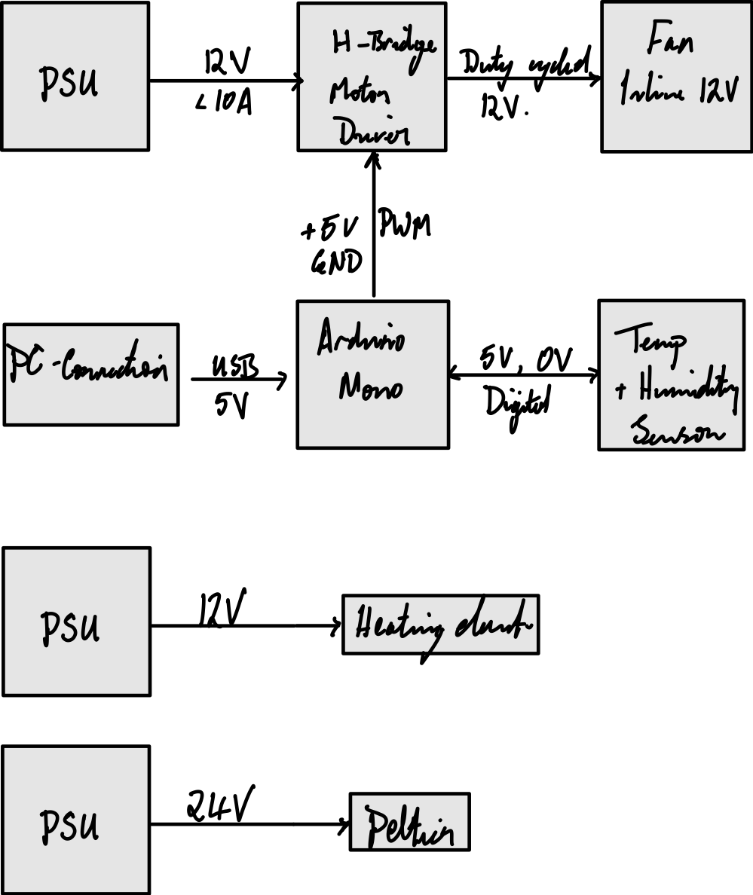
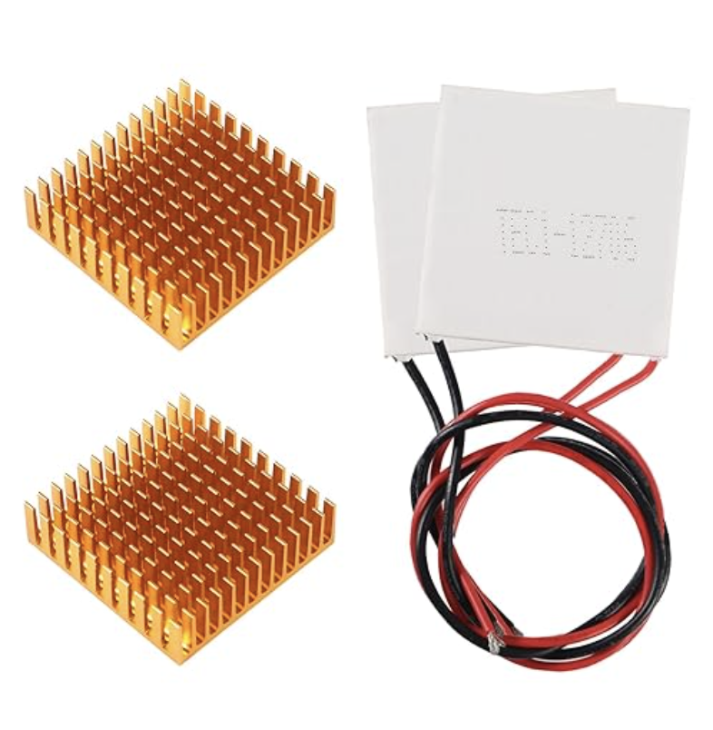
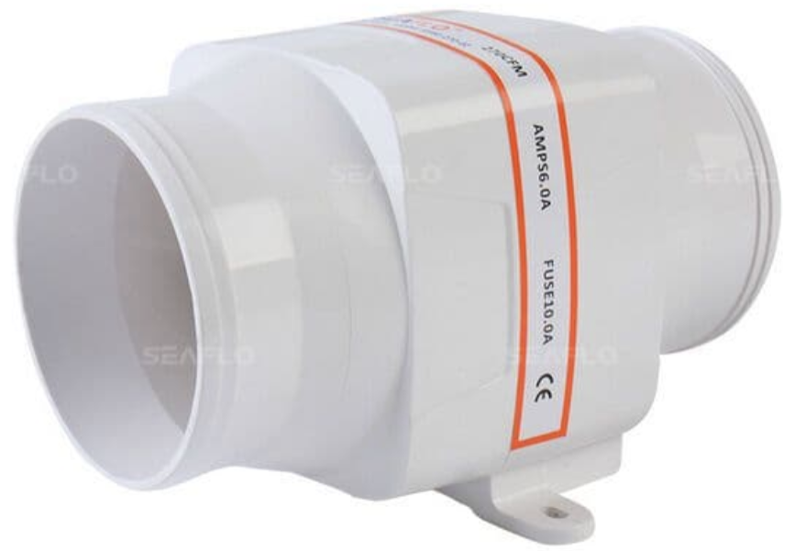
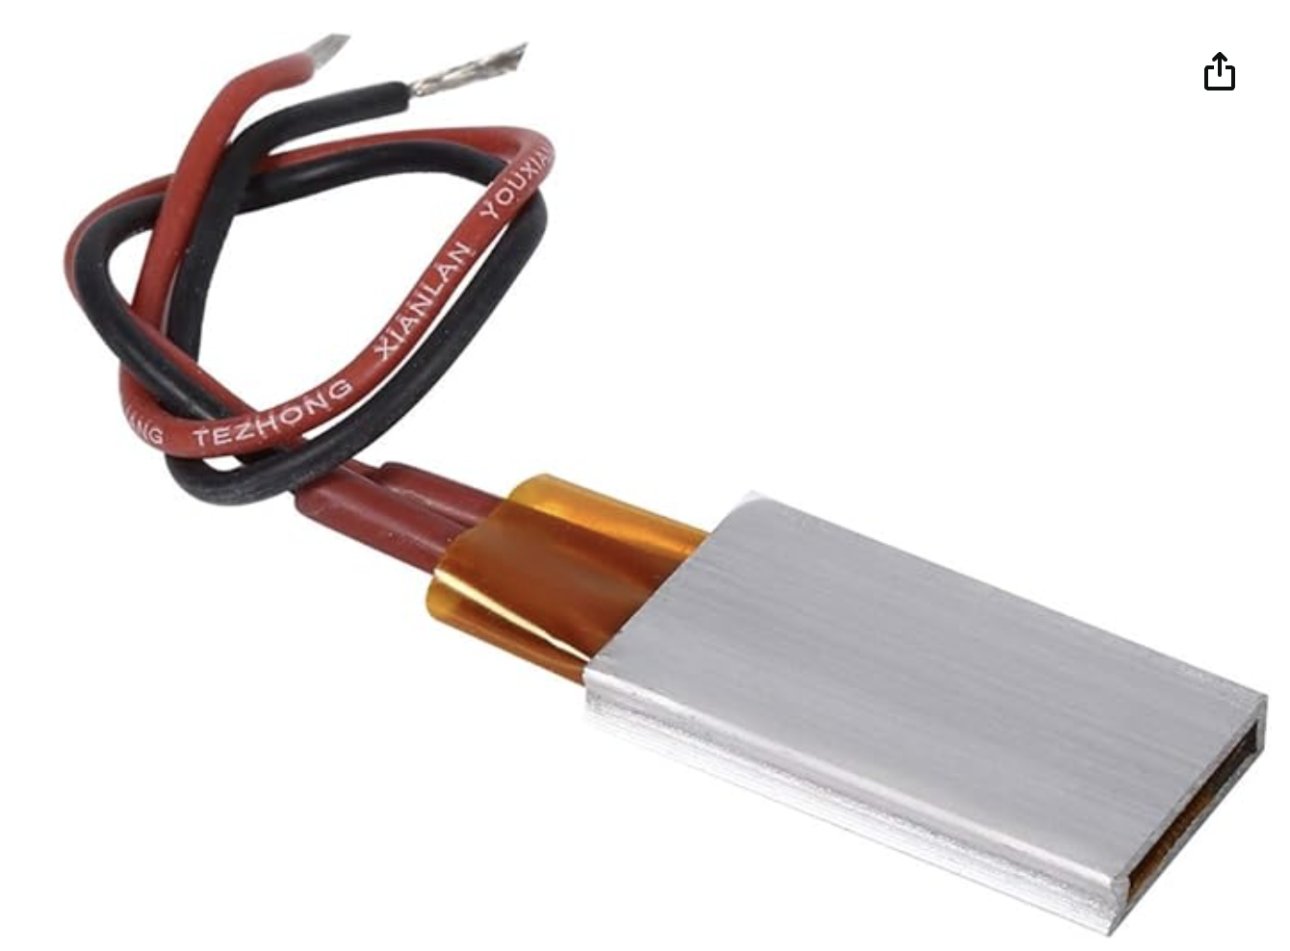
Electrical Design
12V Compatible Design
Power supplies for each component
Notes:
Problem solving + teamwork
Brandon saved the day
The of kevins are evil

Slide 7
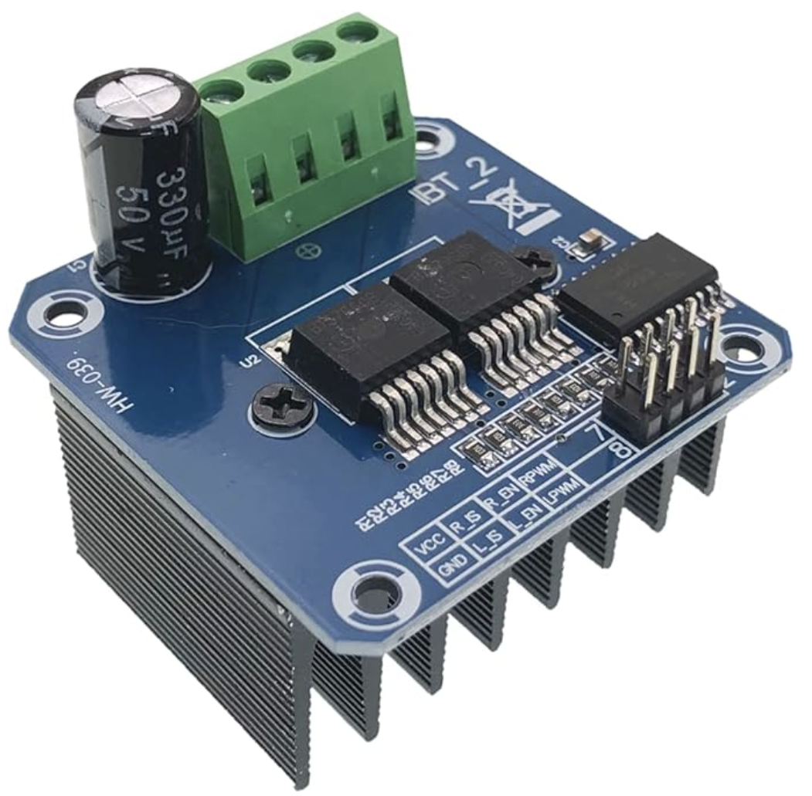
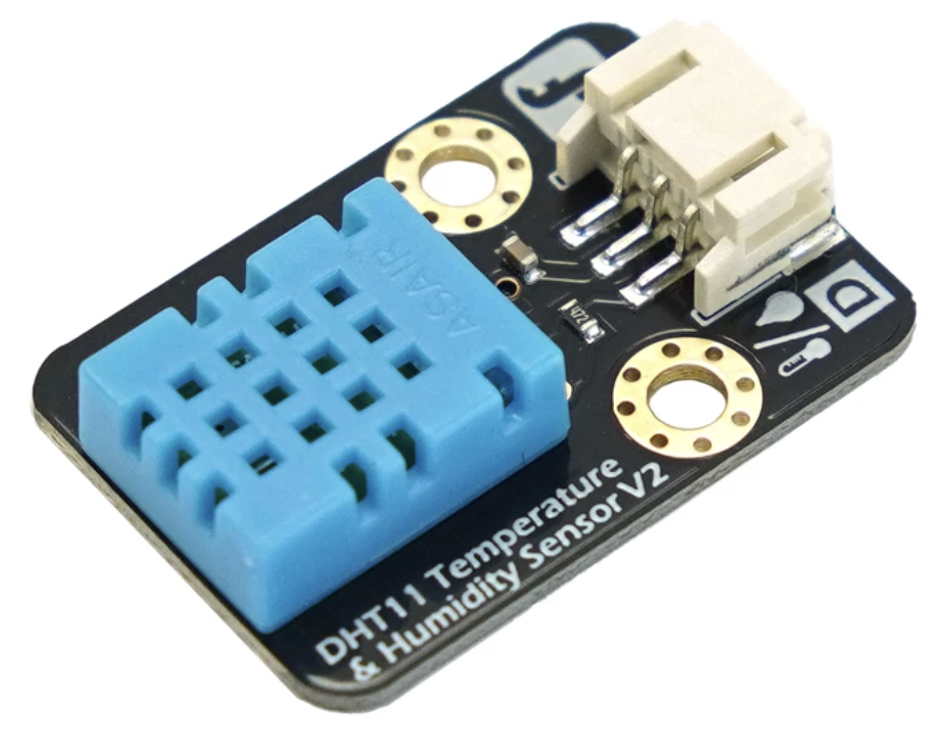
Software
Arduino IDE
PWM fan control
Sensor read
Python serial logger

Slide 8
Experimental Test Plan
Test no. | Description | Fan Duty / %
1 | Peltiers + Heater | 50
2 |  | 75
3 |  | 100
4 | Heater | 50
5 |  | 75
6 |  | 100
7 | Peltiers | 50
8 |  | 75
9 |  | 100
10 | Closed Loop with Peltiers | 75
11 | Closed Loop with Peltiers and Heater | 75

Slide 9
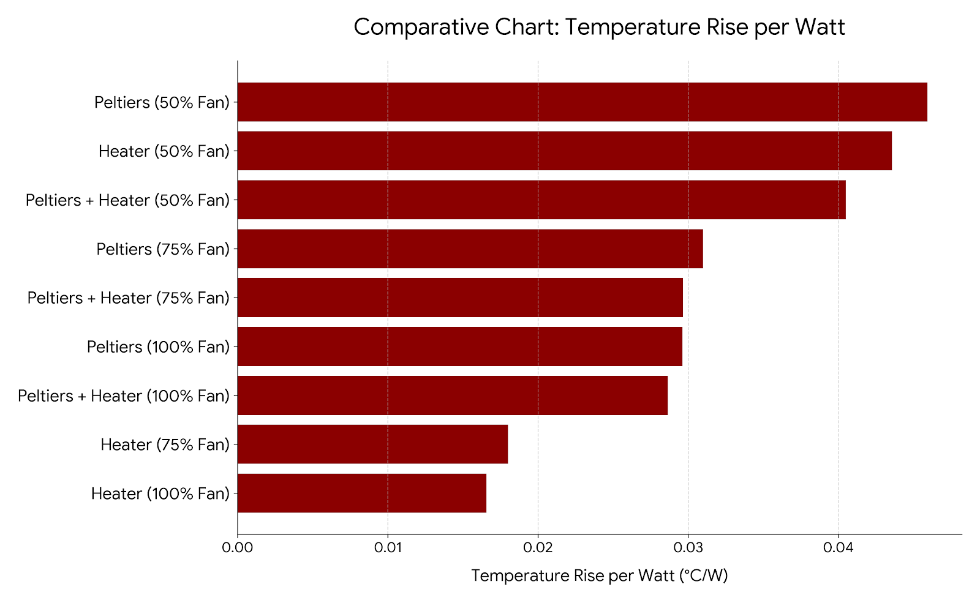
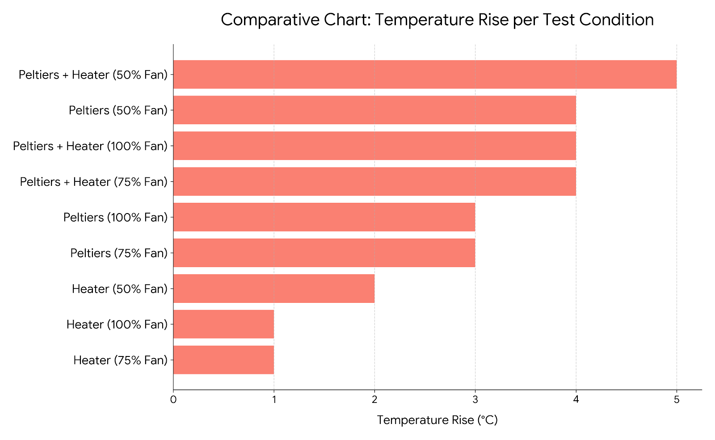
Results

Slide 10
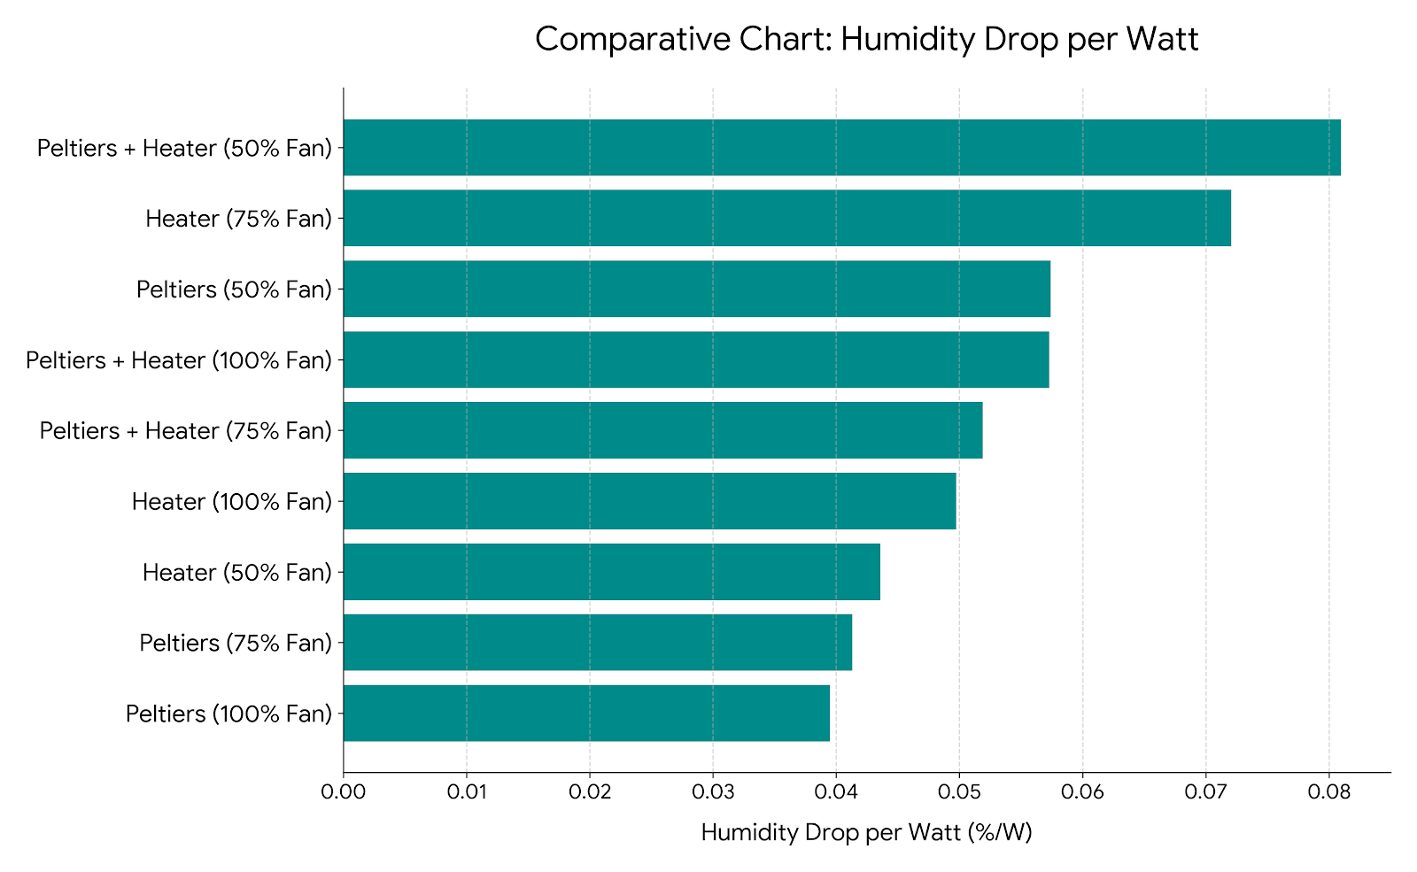
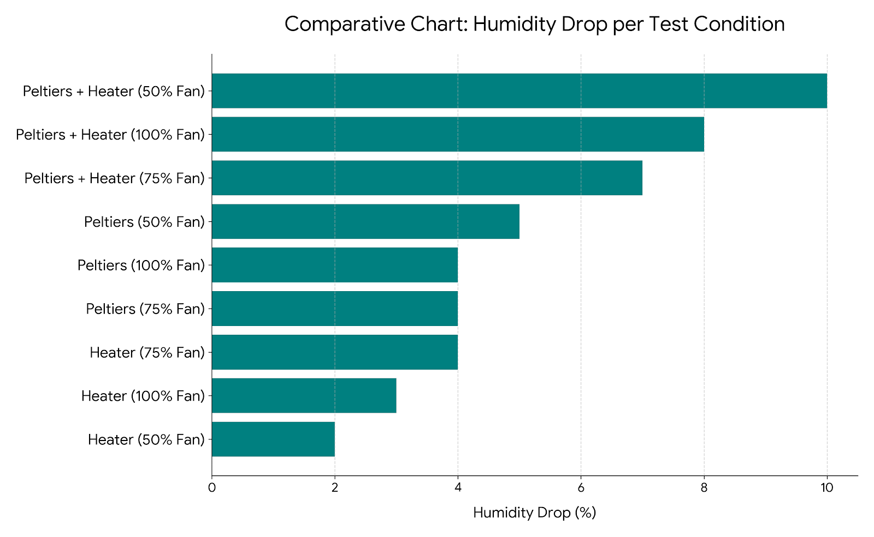
Results

Slide 11
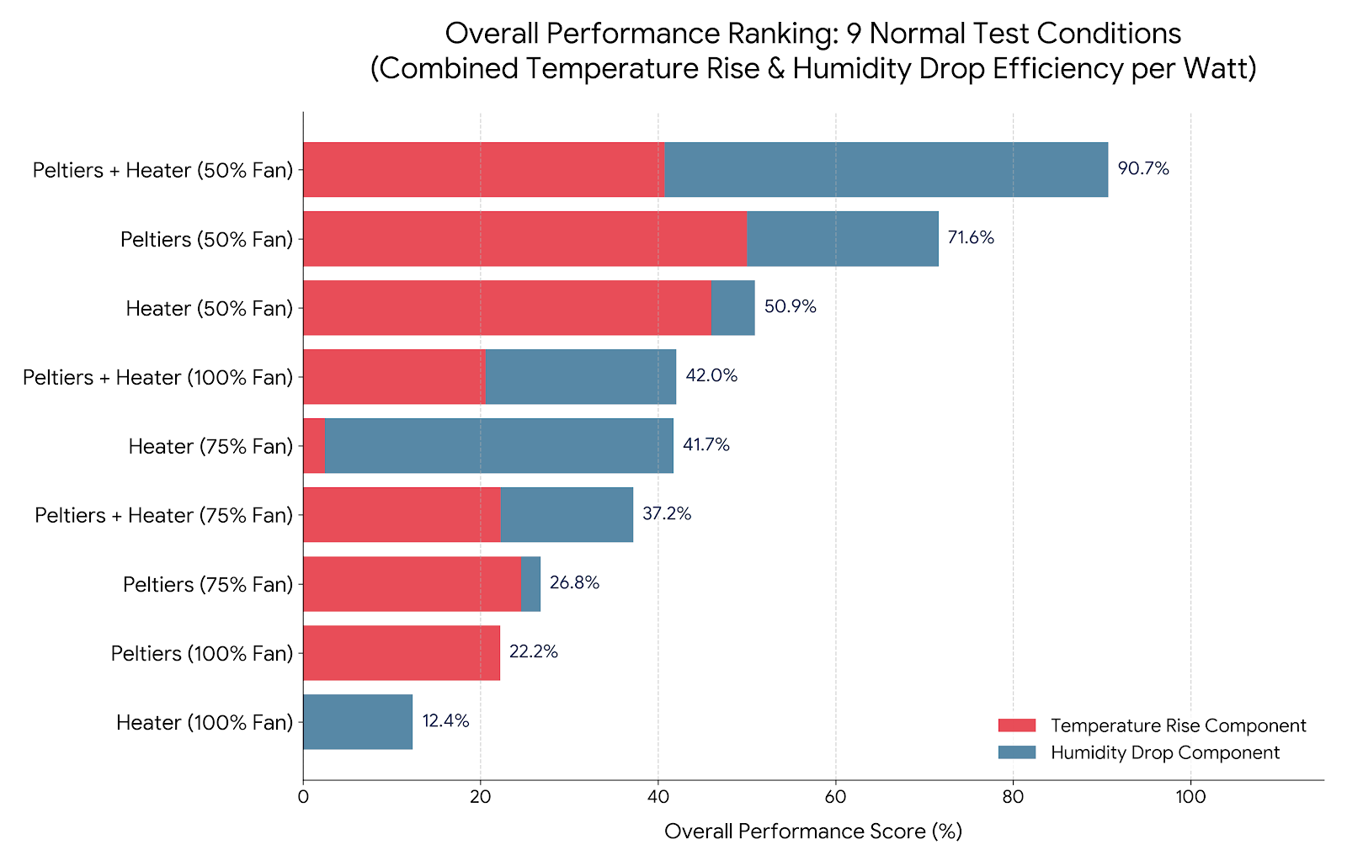
Results
Importantly this does not account for volumetric flow which is an important parameter

Slide 12
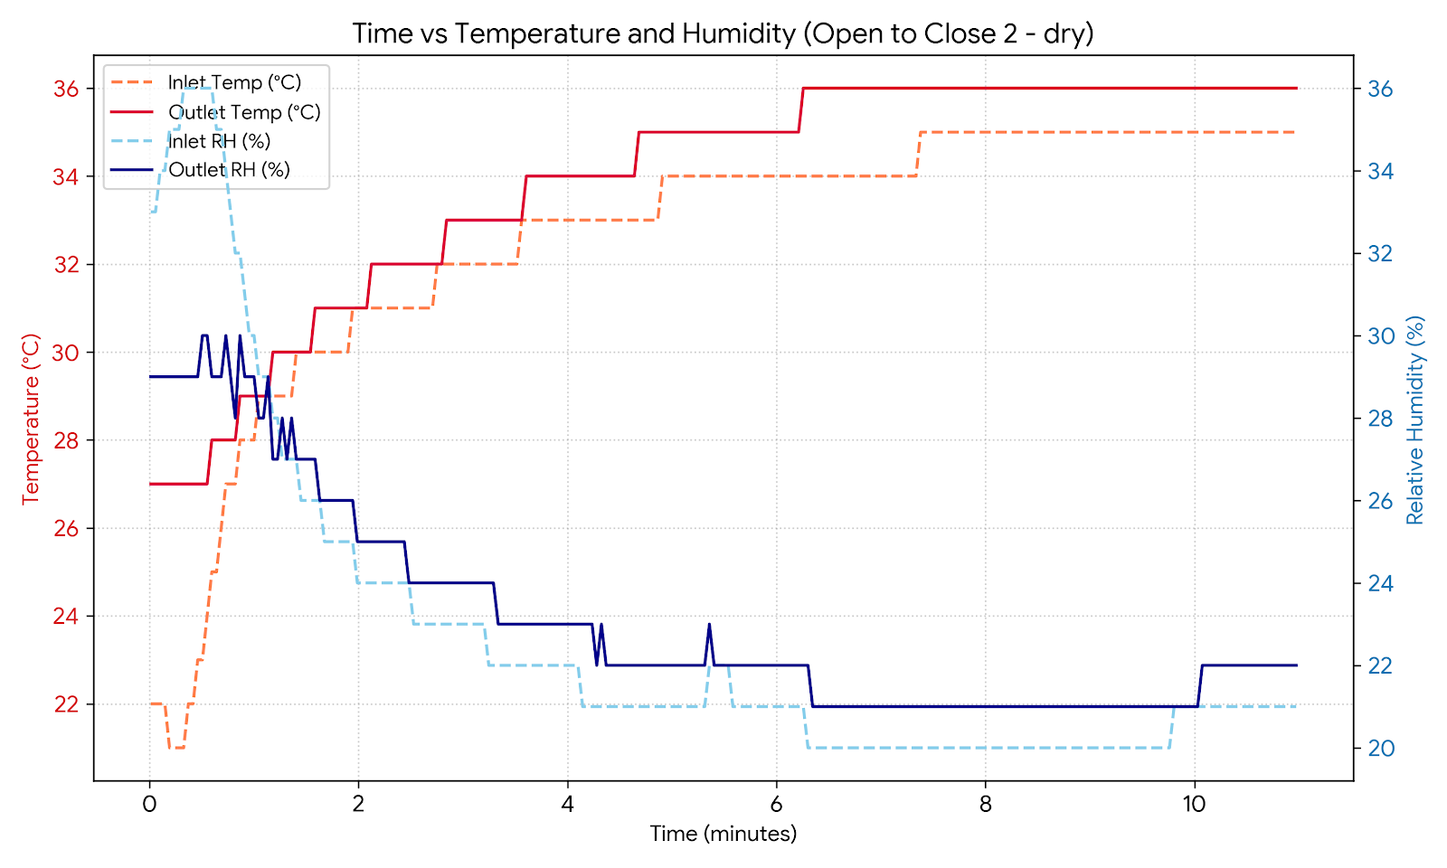
Results

Slide 13
Results
In the closed loop case, we achieved:
A bag temperature of 31°C and Rel Humidity of 22% with just the Peltiers at a power of 94.5W
A bag temperature of 36°C and Rel Humidity of 17% with both Peltiers and the heater at a power of 127.2W
This seems to show that our design is feasible - we would want to test it with a drying load inside to further prove this, but results shows confidence in the design
Notes:
Stack peltiers, to make the cold side colder
Vent moist air
Volumetric flow
Have a representative crop to dry
Use an environmental chamber to control ambient conditions, comparable to usecases

Slide 14
Continued work
Stacking Peltier elements.
Vent moist air
Volumetric flow measurement
Have a representative crop to dry
Test in an environmental chamber
Notes:
Stack peltiers, to make the cold side colder
Vent moist air
Volumetric flow
Have a representative crop to dry
Use an environmental chamber to control ambient conditions, comparable to usecases

